Slide 1
MARKETING ANALYTICS I
SESSION 3:
CONSUMER PERCEPTIONS
Professor Sonnier
Texas MSBA Program
Fall 2022

Slide 2
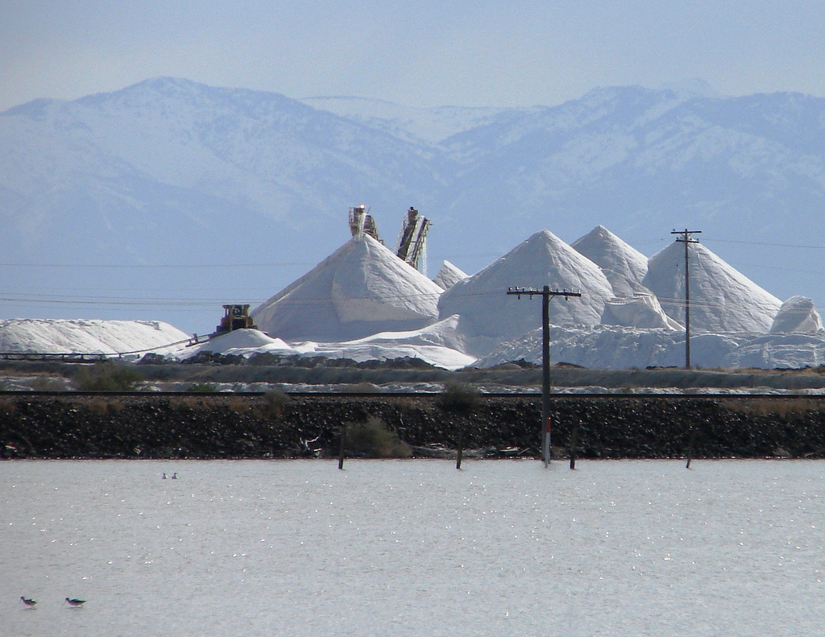
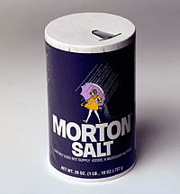
CONSUMER PERCEPTIONS
What is This?

Slide 3
CONSUMER PERCEPTIONS
What is a Brand?
A name, term, sign, symbol, or design, or a combination of them intended to identify the goods and services of one seller or group of sellers and to differentiate them from those of competition
---American Marketing Association

Slide 4
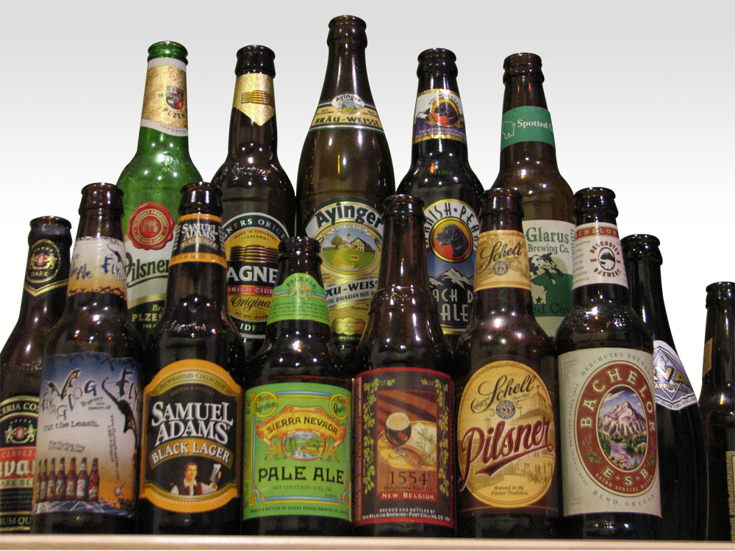
CONSUMER PERCEPTIONS
The Role of Brands
Signal quality

Slide 5

CONSUMER PERCEPTIONS
The Role of Brands: Quality Signal

Slide 6
CONSUMER PERCEPTIONS
The Role of Brands
Signal quality
Image that consumers demand

Slide 7

CONSUMER PERCEPTIONS
The Role of Brands: Forging A Unique and Favorable Image

Slide 8
CONSUMER PERCEPTIONS
The Role of Brands
Signal quality
Image that consumers demand
Valuable asset

Slide 9
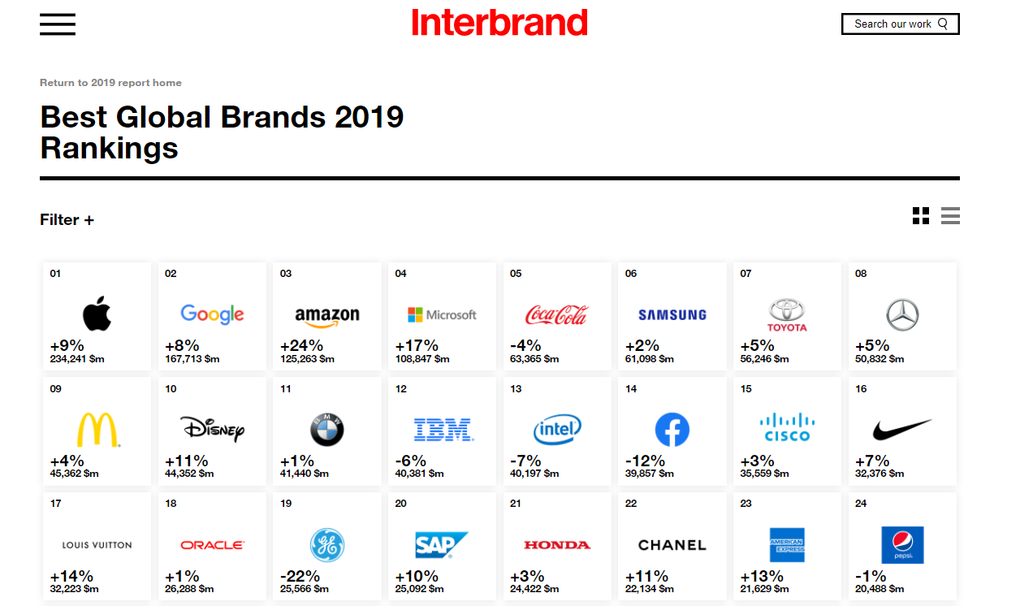
CONSUMER PERCEPTIONS
The Role of Brands: Valuable Asset

Slide 10
CONSUMER PERCEPTIONS
The Role of Brands
Signal quality
Image that consumers demand
Valuable asset
Source of competitive advantage

Slide 11
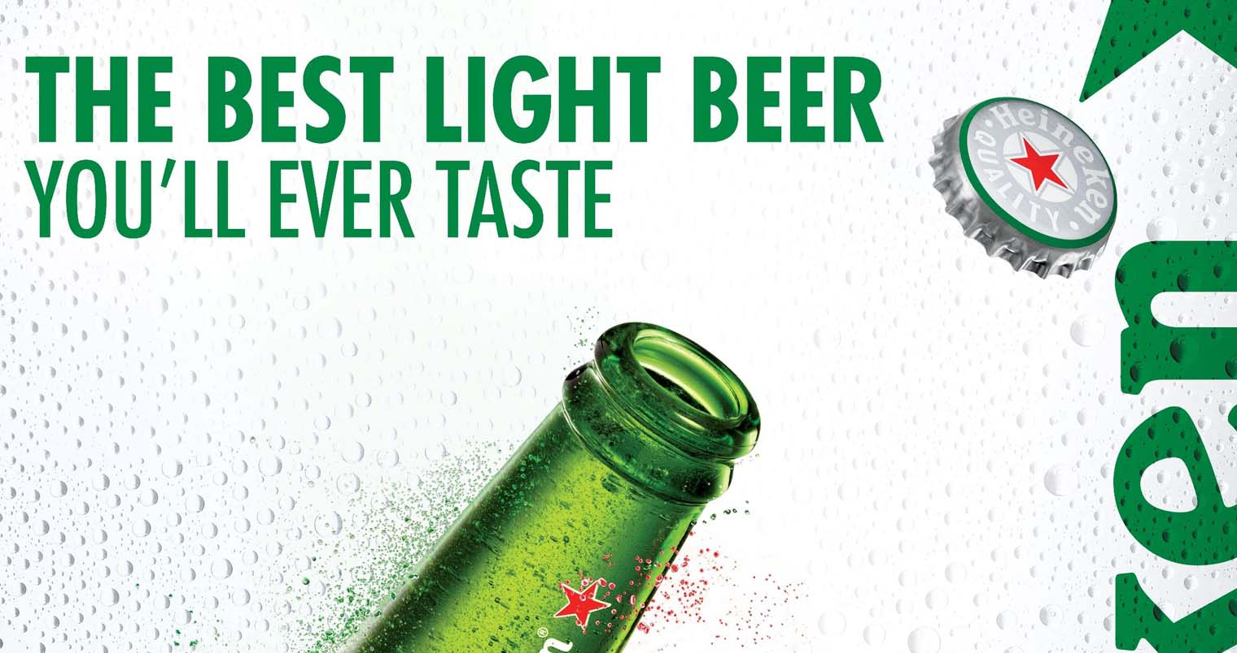
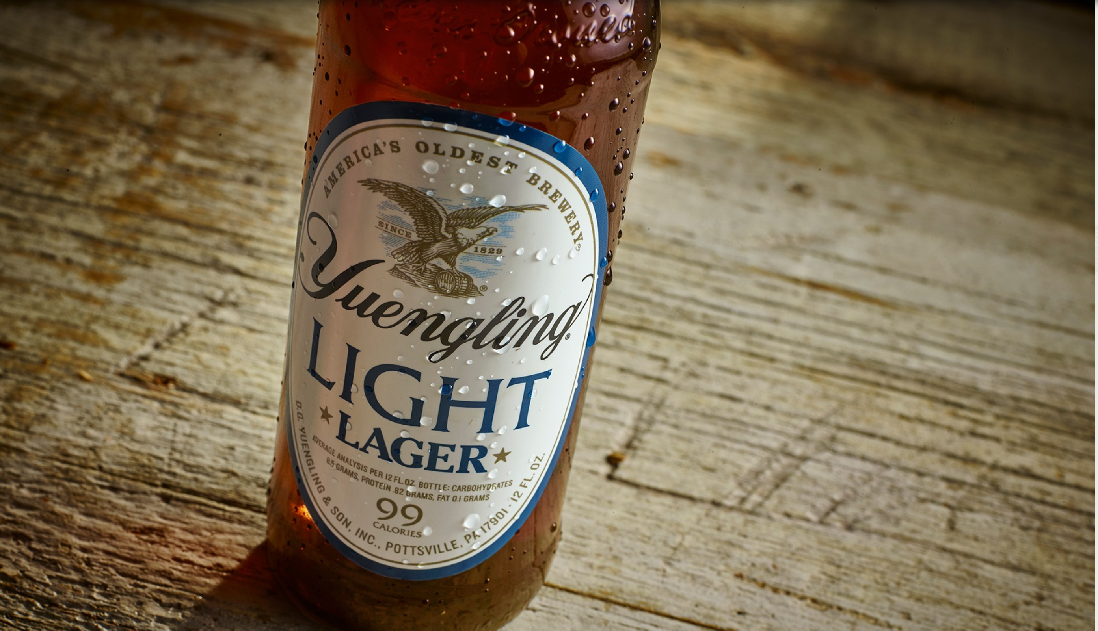
CONSUMER PERCEPTIONS
The Role of Brands: Potential Source of Competitive Advantage
Leveraging an established brand name for a product line extension yields built in awareness and distribution
Can be risky if extension fails, causing damage to the parent brand

Slide 12
MARKETING ANALYTICS
Types of Customer Value
Functional
Customer Value
Value in Use
Experiential

Slide 13
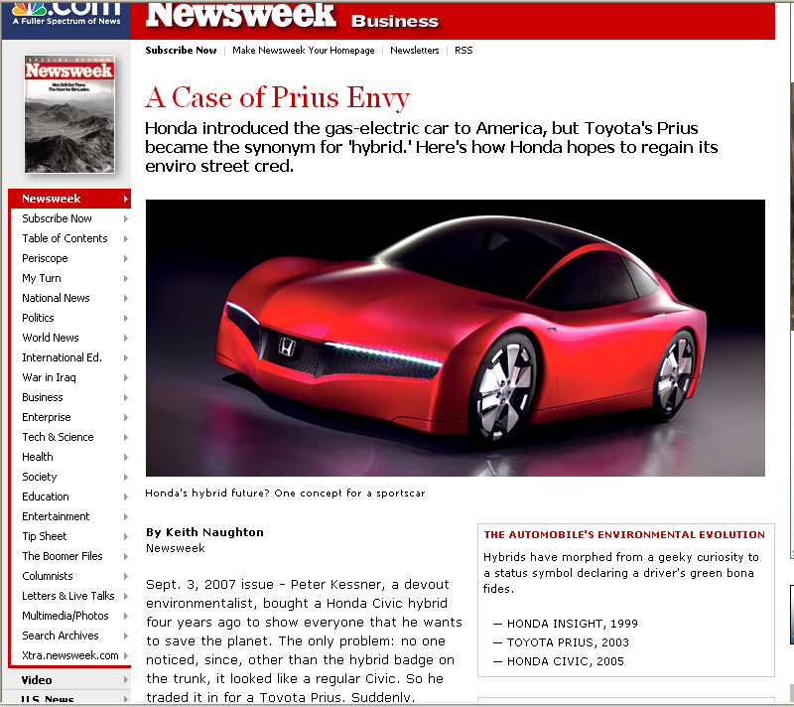

CONSUMER PERCEPTIONS
Experiential Value
Peter Kessner, a devout environmentalist, bought a Honda Civic hybrid four years ago to show everyone that he wants to save the planet. The only problem: no one noticed, since, other than the hybrid badge on the trunk, it looked like a regular Civic. So he traded it in for a Toyota Prius. Suddenly, strangers began stopping him on the street to ask about his hybrid, with its space-age styling and miserly mileage. "That's a big part of why I bought the Prius," says the Floral Park, N.Y., retiree. . . . The Honda, on the other hand, didn't deliver what Kessner craved: green street cred. "If I'm driving a hybrid," he says, "I want people to know it."

Slide 14
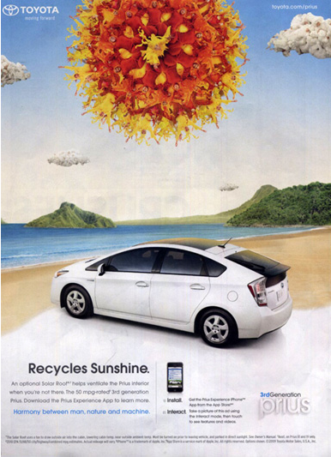
THE DECISION MAKING PROCESS
Experiential Value

Slide 15
CONSUMER PERCEPTIONS
Experiential Value
Price
P’
Brand Value
P
D_{Prius}
D_{Civic Hybrid}
Q
Q’
Quantity

Slide 16
CONSUMER PERCEPTIONS
Experiential Value
Demand More Responsive to Price Changes
Demand Less Responsive to Price Changes
Price
Price
P’
P’
P
P
D_{Prius}
D_{Prius}
D_{Civic Hybrid}
D_{Civic Hybrid}
Q
Q’
Quantity
Q
Q’
Quantity
Smaller price change required to close quantity gap.
Larger price change required to close same quantity gap.

Slide 17
CONSUMER PERCEPTIONS
Quantifying Experiential Value
Find the price difference that sets Q^{brand 1} = Q^{brand 2}

Slide 18
CONSUMER PERCEPTIONS
Quantifying Experiential Value
Price
50
40
D^{brand 1}
D^{brand 2}
Quantity
80
100

Slide 19
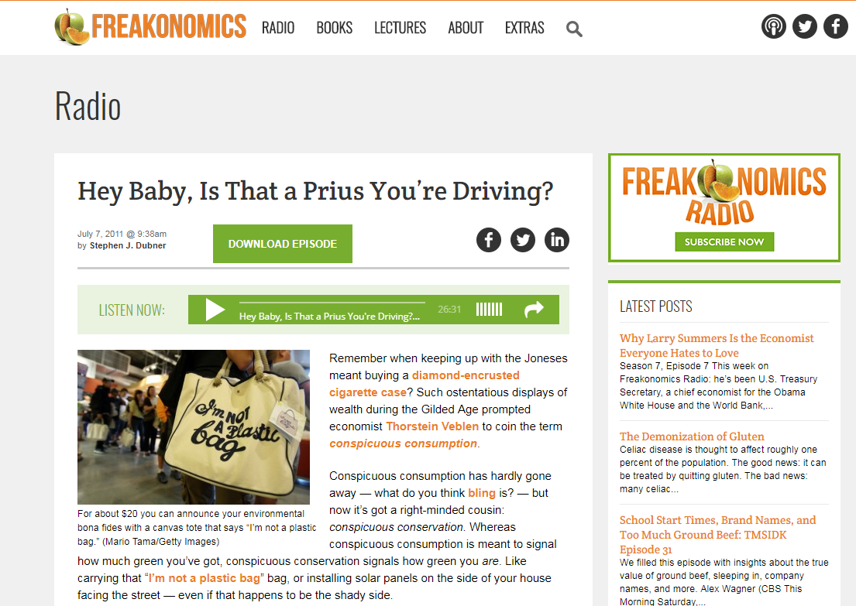
CONSUMER PERCEPTIONS
Experiential Value

Slide 20
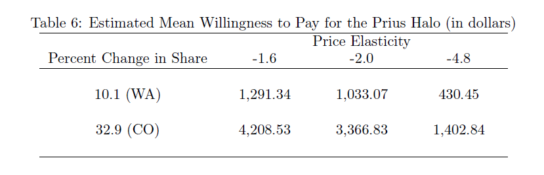
CONSUMER PERCEPTIONS
Experiential Value
At same price, Prius gets 10% more market share in Seattle compared to Civic Hybrid
At high demand elasticities a $430 price premium is required to close the share difference
At low demand elasticities a $1,291 price premium is required to close the share difference

Slide 21
CONSUMER PERCEPTIONS
Experiential Value
At same price, Prius gets 33% more market share in Boulder compared to Civic Hybrid
At high demand elasticities a $1,400 price premium is required to close the share difference
At low demand elasticities a $4,200 price premium is required to close the share difference

Slide 22
CONSUMER PERCEPTIONS
Visualizing Perceptions and Preferences

Slide 23
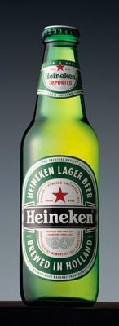
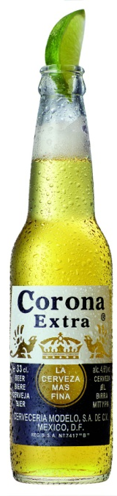
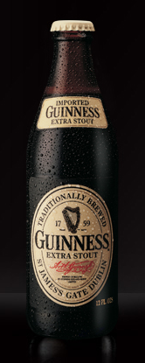
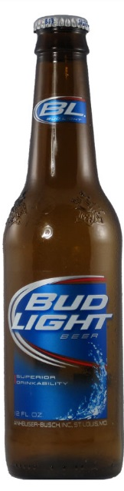
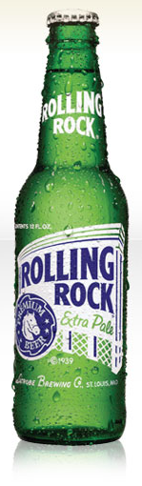
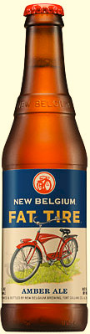
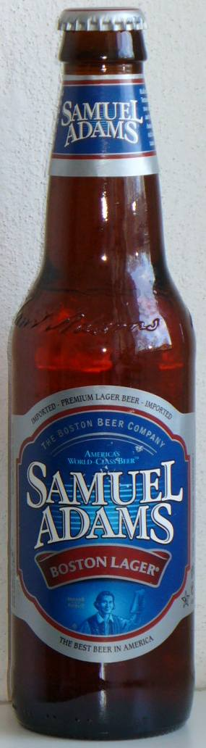
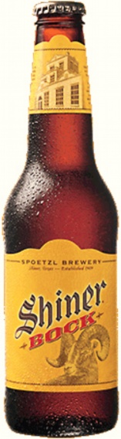
CONSUMER PERCEPTIONS
Beer Ratings

Slide 24
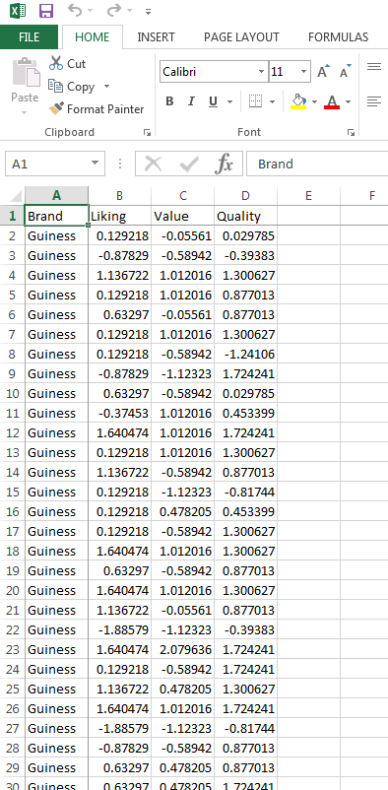
CONSUMER PERCEPTIONS
Beer Ratings (Data in Session 3 Folder on Canvas)
Consumers rate each beer brand in terms of their liking for the brand, and their perceptions of value and quality
Raw ratings are on a 7 point scale
Data are transformed to z-scores with mean zero and unit variance (i.e., variance=1)

Slide 25
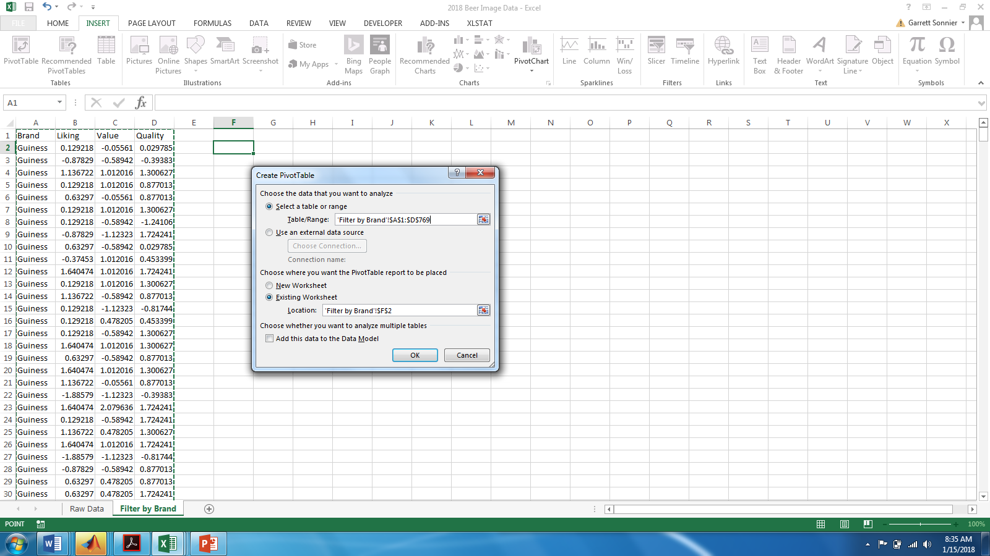
CONSUMER PERCEPTIONS
Beer Ratings Filtered by Brand

Slide 26
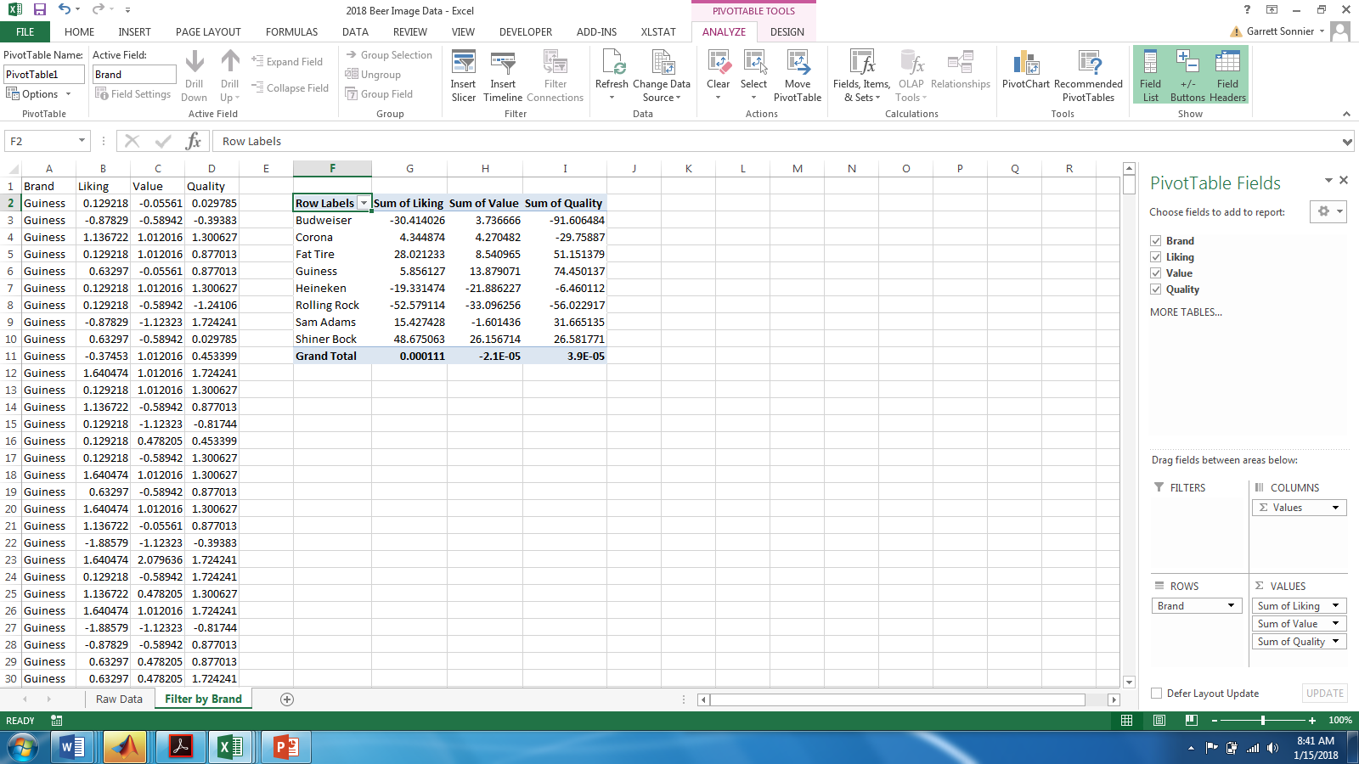
CONSUMER PERCEPTIONS
Beer Ratings Filtered by Brand

Slide 27
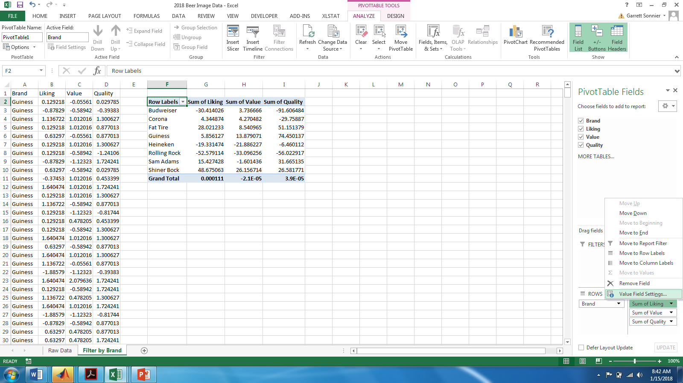
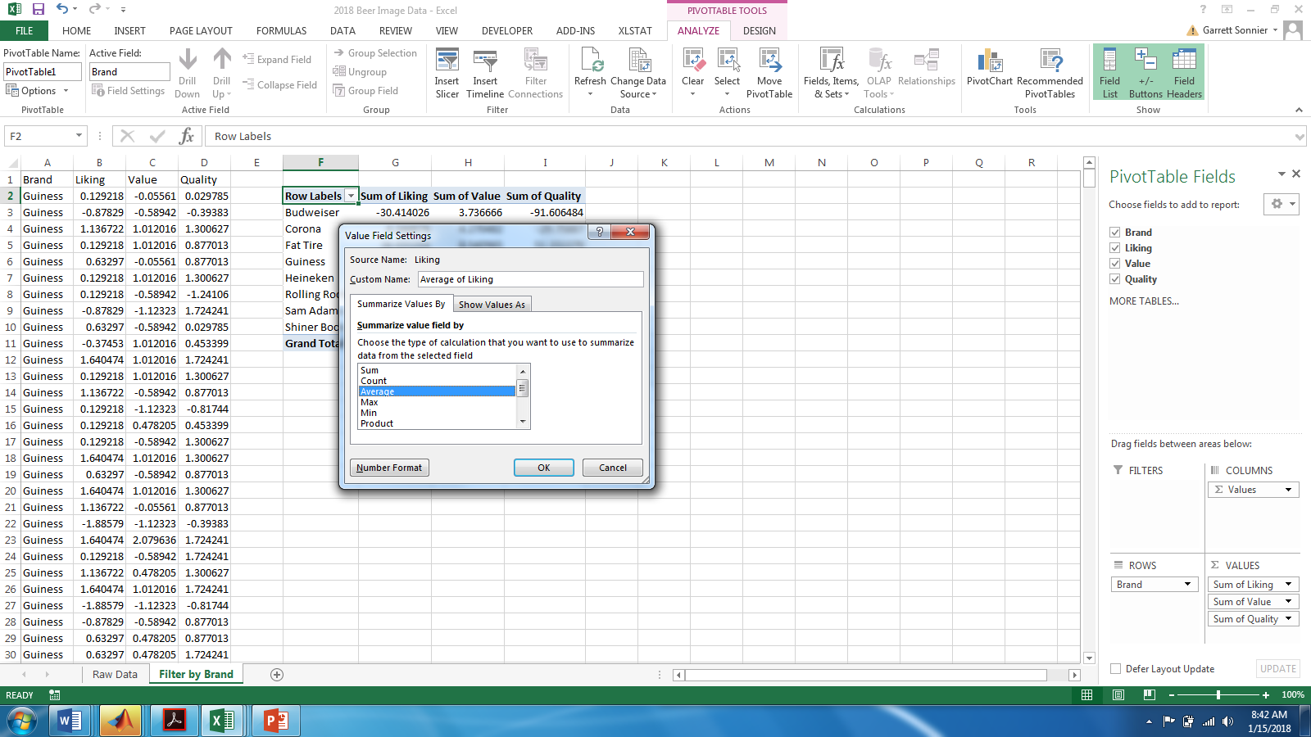
CONSUMER PERCEPTIONS
Beer Ratings Filtered by Brand

Slide 28
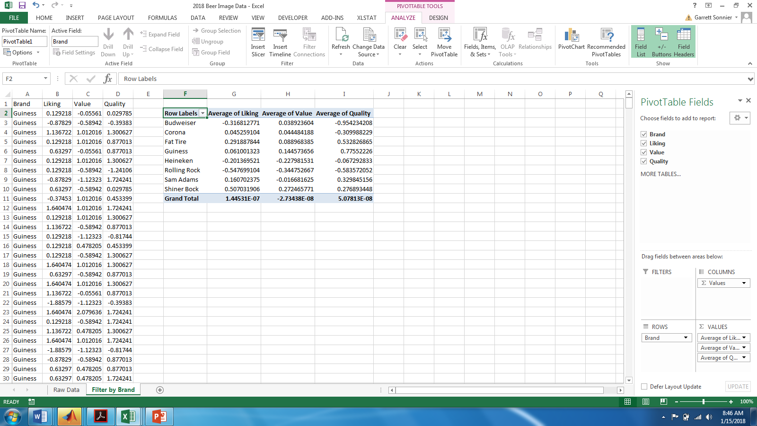
CONSUMER PERCEPTIONS
Beer Ratings Filtered by Brand

Slide 29
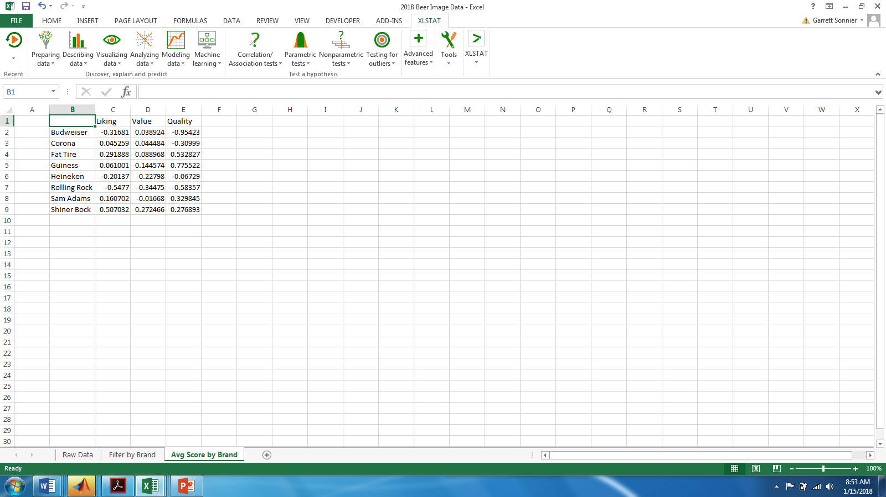
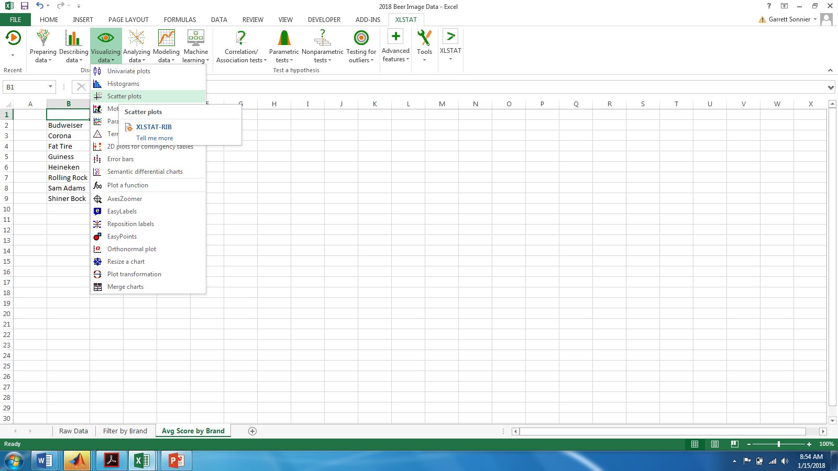
CONSUMER PERCEPTIONS
Mapping the Average Brand Ratings

Slide 30
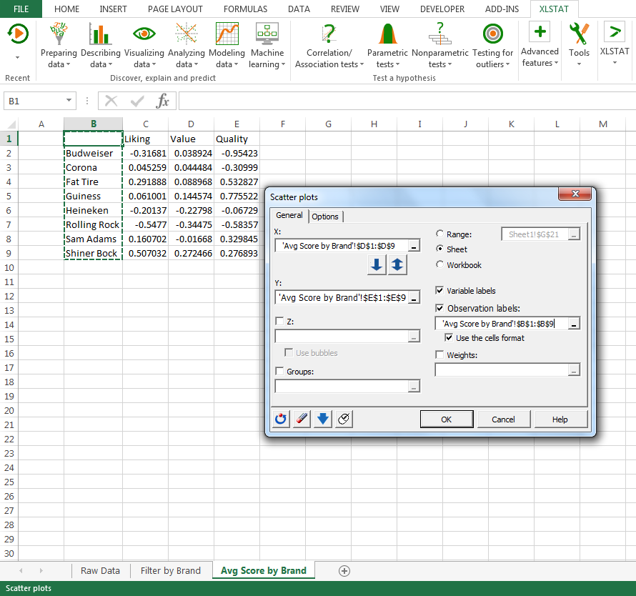
CONSUMER PERCEPTIONS
Mapping the Average Brand Ratings
Scatterplot used to map the average brand ratings
We put Value on the X axis and Quality on the Y axis
Note the observation labels which will label each point with the corresponding brand name

Slide 31
CONSUMER PERCEPTIONS
Brand Map
Assuming both Value and Quality impact Brand Liking positively…
NE quadrant is good
SW quadrant is bad
NW quadrant is high quality but low value
SE quadrant is high value but low quality
Where is the best place in the NE quadrant?
Are NW/SE positions good or bad?
The answer depends on the relation between brand image and brand liking
NOTE: x-axis is Value, y-axis is Quality

Slide 32
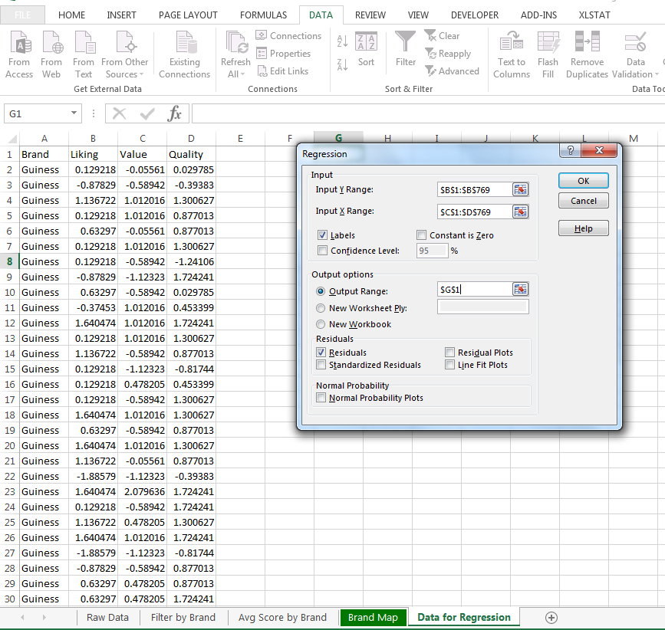
CONSUMER PERCEPTIONS
The Relationship Between Brand Liking and Brand Image
Regression analysis used to investigate the relationship between brand liking and brand image
The dependent y variable is liking
The independent X variables are Value and Quality
Make sure Labels box is checked
Check residuals box to automatically generate predicted values

Slide 33
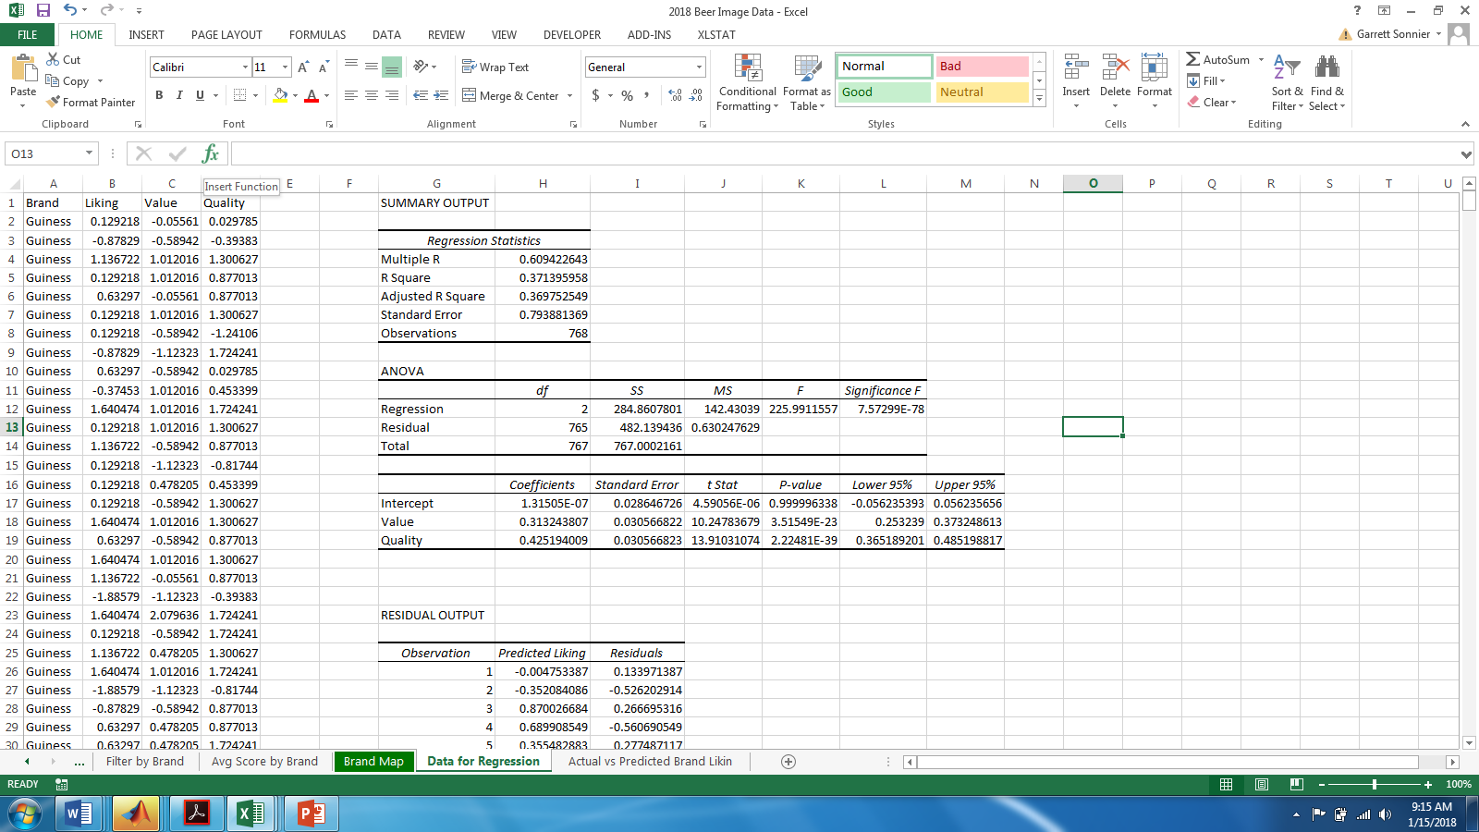
CONSUMER PERCEPTIONS
The Relationship Between Brand Liking and Brand Image

Slide 34
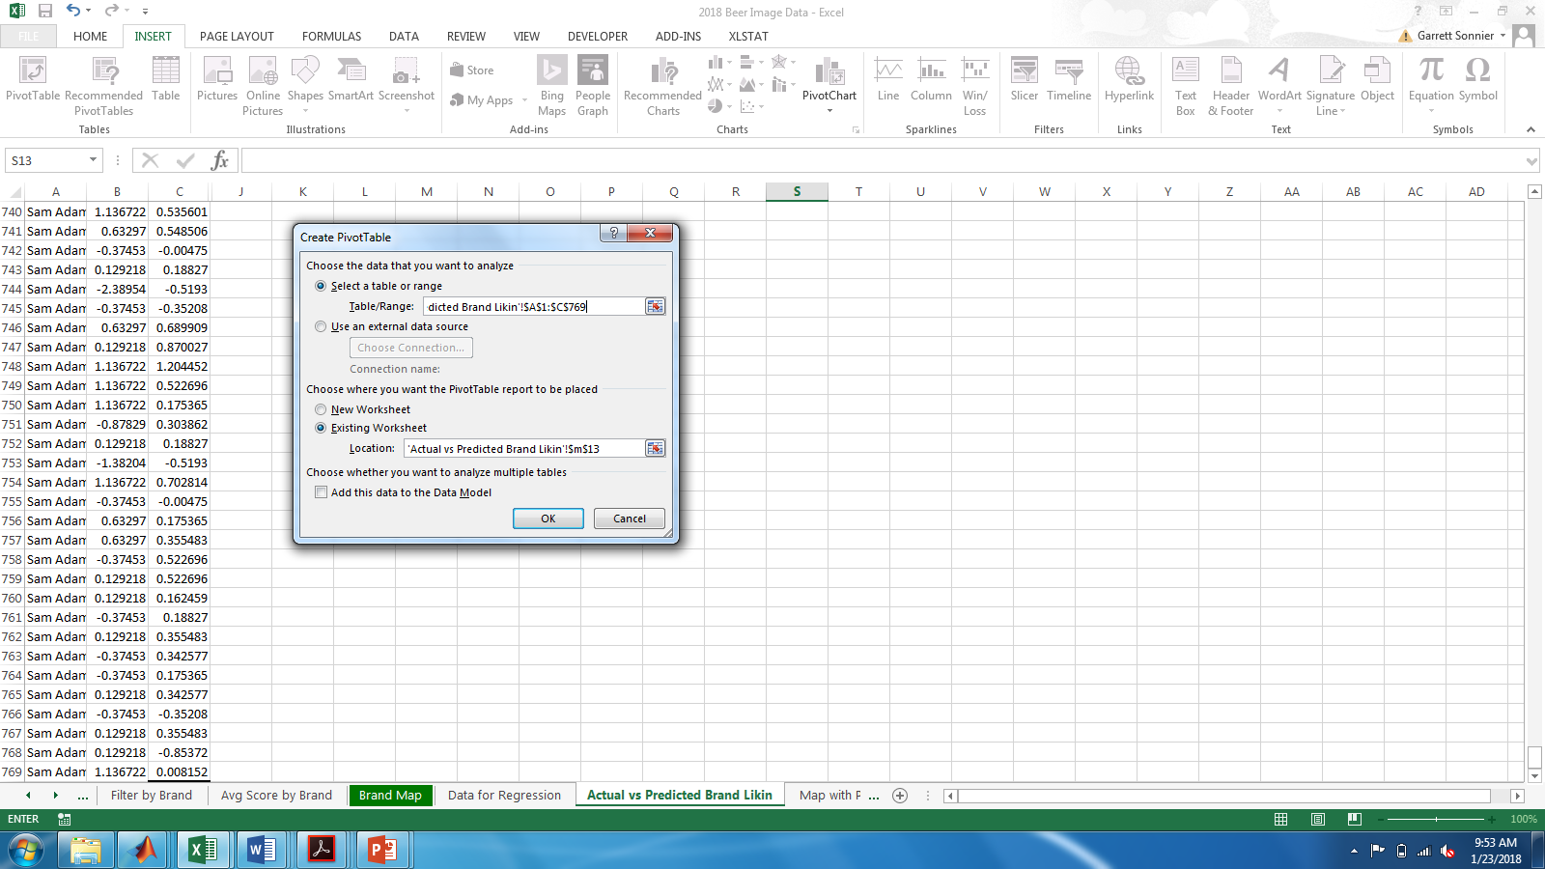
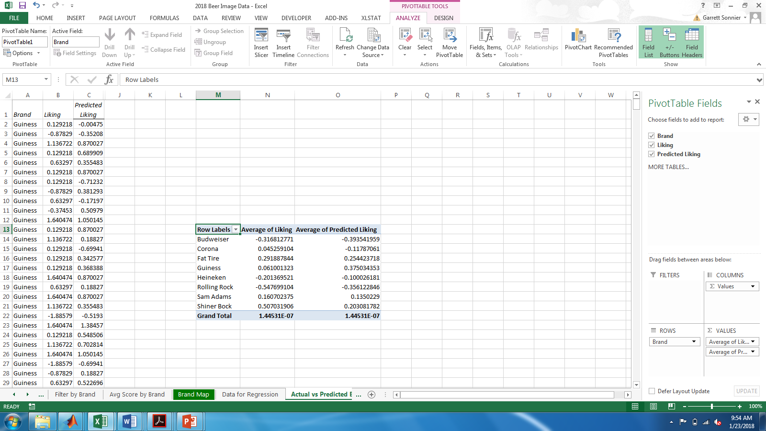
CONSUMER PERCEPTIONS
How Well Does the Model Predict Brand Liking?

Slide 35
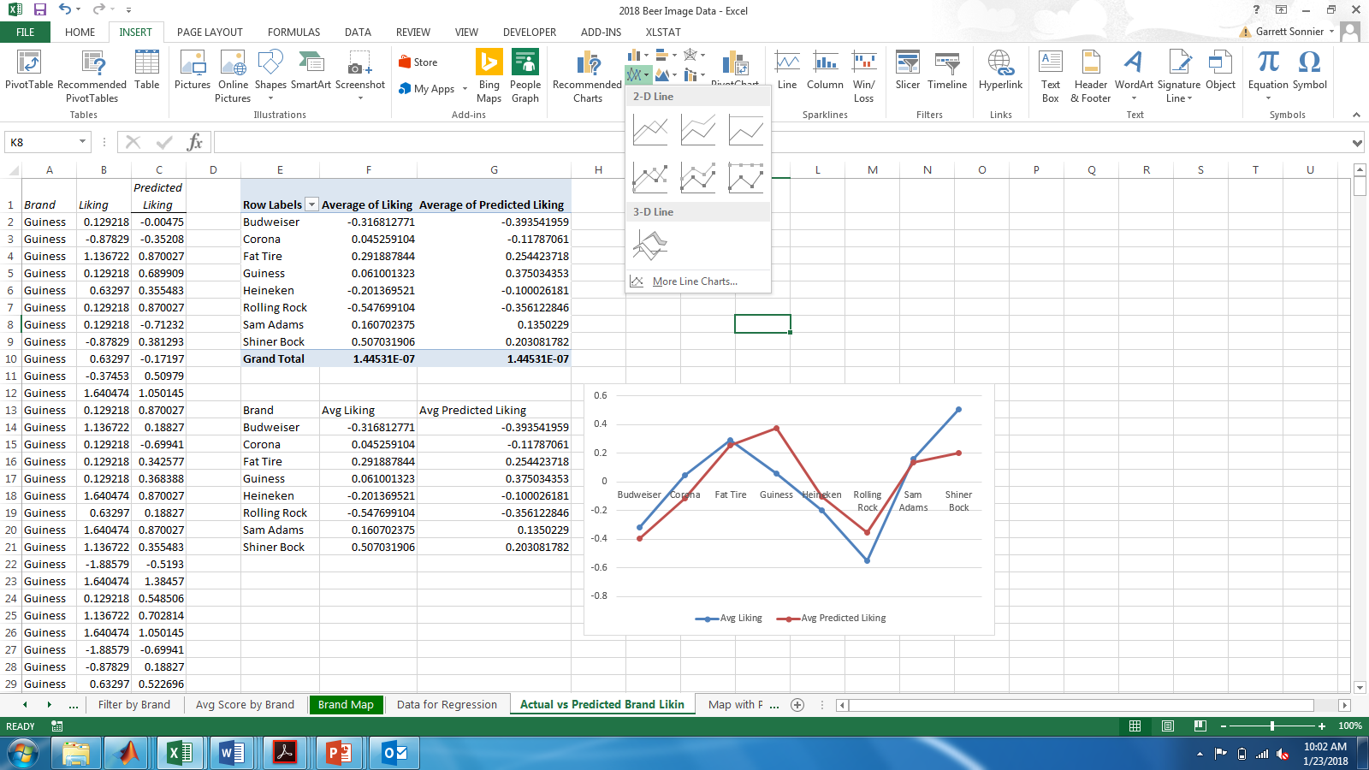
CONSUMER PERCEPTIONS
How Well Does the Model Predict Brand Liking?

Slide 36
CONSUMER PERCEPTIONS
Observed vs Predicted Brand Liking
NOTE: Zero is average

Slide 37
CONSUMER PERCEPTIONS
Data Visualization: How do we Graphically Represent Brand Liking?
NOTE: x-axis is Value, y-axis is Quality

Slide 38
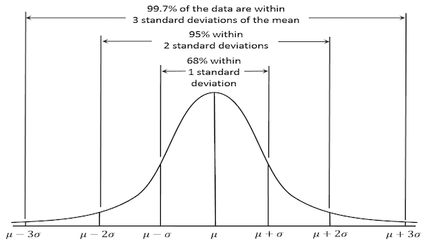
CONSUMER PERCEPTIONS
Data Visualization: How do we Graphically Represent Brand Liking?

Slide 39
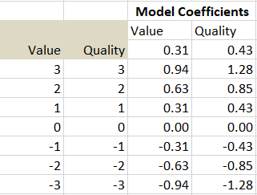
CONSUMER PERCEPTIONS
Adding the Liking to the Image Map
The data are mean zero with std. deviation one
Thus we can consider moves of 1-3 standard deviations around the mean
What would contribution to Opinion be if Value score is 3? It would be 3 x 0.31 = 0.94
What would contribution to Opinion be if Quality score is also 3? It would be 3 x 0.43=1.28

Slide 40
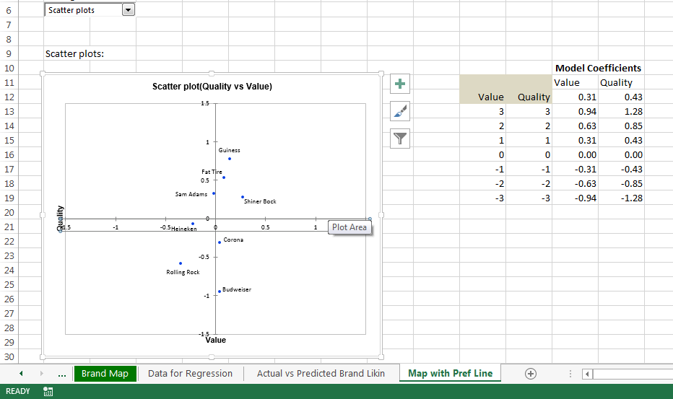
CONSUMER PERCEPTIONS
Adding the Liking to the Image Map
NOTE: x-axis is Value, y-axis is Quality

Slide 41
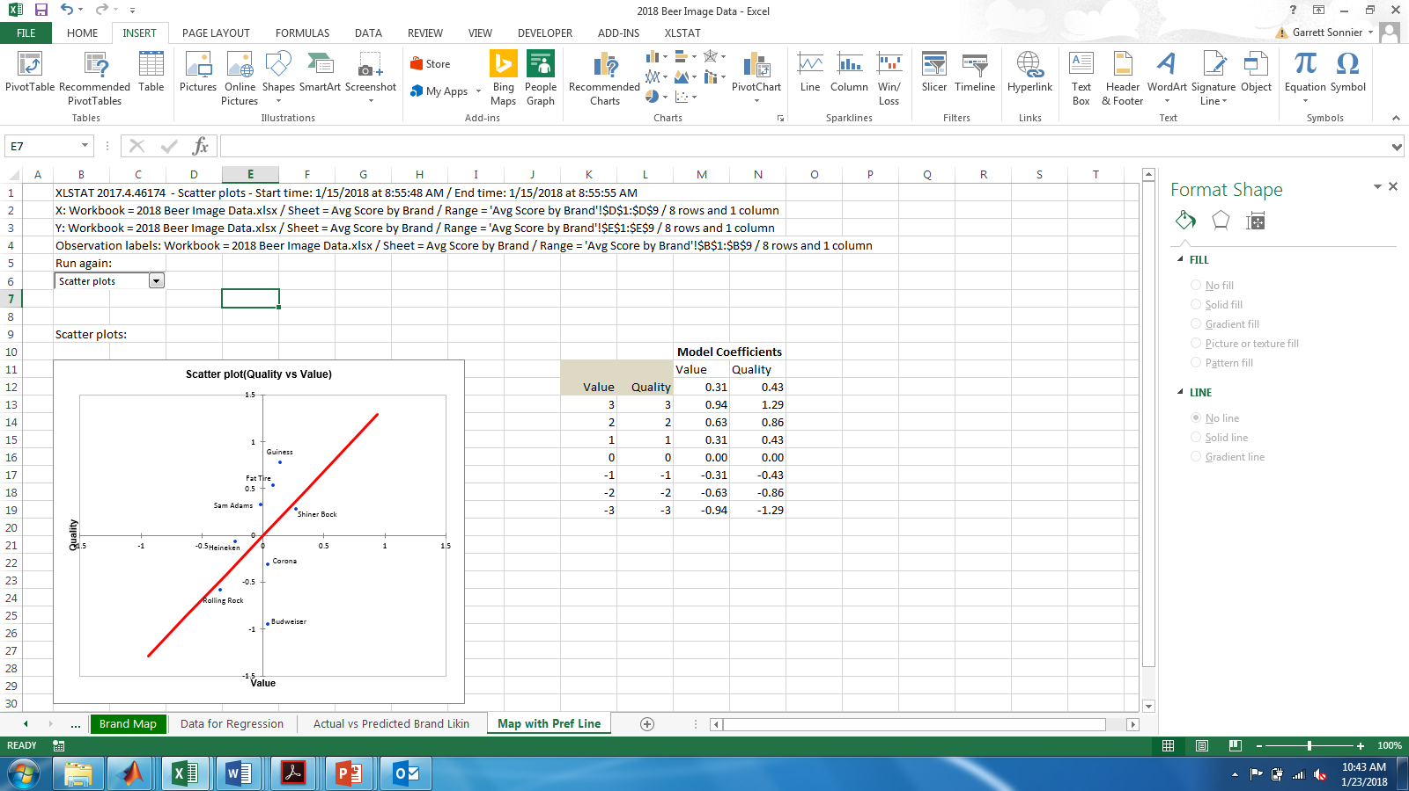
CONSUMER PERCEPTIONS
What Do You Think Determines the Slope of this Line?
NOTE: x-axis is Value, y-axis is Quality

Slide 42
CONSUMER PERCEPTIONS
Consider Shiner Bock, Fat Tire and Guiness
Which is most liked and least liked?
What if value mattered more?

Slide 43
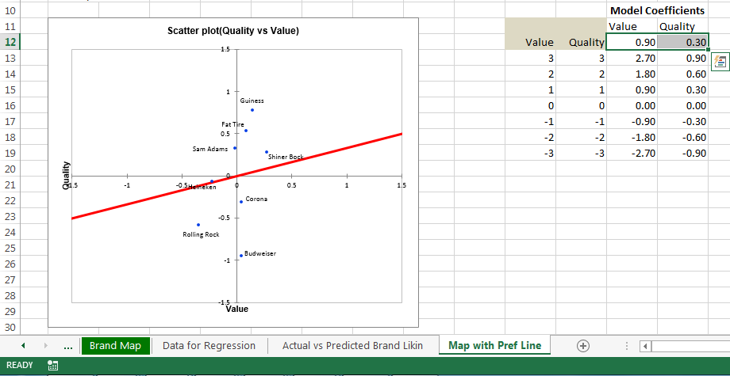
CONSUMER PERCEPTIONS
Consider Shiner Bock, Fat Tire and Guiness
What if value mattered more?
Which is most liked and least liked?

Slide 44
MARKETING ANALYTICS
Key Concepts from Today
Brands provide value to customers
Image that consumers demand
Signal of quality
Quantifying the experiential value of a brand or product is challenging
When products are similar in terms of physical characteristics demand analysis provides insights into experiential value
Perceptual maps can be used to visualize brand positions and the relationship between preference and position

